Slide 1
Programming II Course
Inheritance
Antonio Di Monaco
Computer Science Bachelor Program

Slide 2
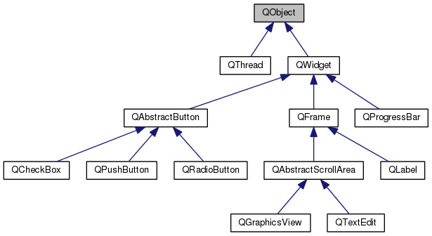
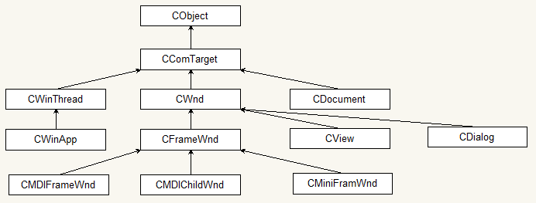
Why inheritance?
It helps us create new classes built on existing ones.
we can reuse our code and extend it
we can modify our code keeping the same interface
we can scale our code complexity by designing the ”is-a” relationship properly (example: UI frameworks)

Slide 3
Superclasses and subclasses
superclass base class
parent class
subclass derived class
child class
public class Manager extends Employee {
private double bonus;
public Manager(....) {
super(....);
....
}
...
public void setBonus(double bonus) {
this.bonus = bonus;
}
public double getSalary() {
double baseSalary = super.getSalary();
return baseSalary + bonus;
}
}
all non-private
employee fields
and methods
are available
Subclasses have more functionalities and/or states
than superclasses
There’s a difference between
the super call in the constructor
and the super. call in methods.
First one is required because we
cannot access private fields of
the superclass, but we need to initialize them (so, we need to call the constructor).
In the methods we can call just the non-private items, but we need a way to not trigger
a recursive call by using this.
In Java all non-private methods
are virtual and overridable
(dynamic dispatch)
Overidden methods can call superclass
ones through the super. syntax.

Slide 4
Inheritance
(Manager project)

Slide 5
Polymorphism
“is-a” relationship means that every object of the subclass is an object of the superclass.
Every Manager is an Employee ... but the opposite is not true.
Employee e = new Employee(...);
e = new Manager(...);
Employee e1 = new Employee(...);
e1.setBonus(...); // ERROR!!!
Manager m = e1; // ERROR!!!
All objects are polymorphic, i.e. the dynamic dispatch selects the method to be called based on the
type of the instance and not on the type of the reference.
Inheritance can be prevented using the keyword final, it can be used both on classes and methods.

Slide 6
Casting
Casting is a forced conversion from one type to another.
var staff = new Employee[3];
staff[0] = new Manager(....);
staff[1] = new Employee(....);
....
....
Manager boss = (Manager) staff[0];
We need casting here to access all Manager features.
If the cast does not apply (example, we cast the element
at index [1]), we get an exception.
Casting is 99.99% a bad idea, it should be allowed only in very specific cases, when no other option is available.
To avoid a cast failure, the runtime type can be inspected via the instanceof keyword.
if (staff[i] instanceof Manager) {
boss = (Manager) staff[i];
...
}

Slide 7
Protected access
Protected is a third access level, available only in “is-a” relationship, i.e. from superclasses to subclasses.
Protected access level makes sense for methods that should be visible by subclasses only. It’s risky for
fields though, because this could break encapsulation.
Protected access is visible to all subclasses as well as other classes in the same package! :( Not nice, Java.
Use packages to at least make sense of it.
(PackagedEmployee_Protected project)

Slide 8
Abstract classes
An abstract class is a class that contains abstract methods in it, i.e. methods that do not offer any implementation, that will be delegated to their subclasses.
Thus, they cannot be allocated.
Instead of abstract classes a parent class can be defined with default implementation for methods that should be abstract, but that would lead to a poor design. abstract enforces a specific class interface, subclasses are then obliged to provide the right implementation.
Abstract classes make more sense when used with interfaces, because can provide a first common code scaffold for later subclasses that implements the full interface.
Abstract classes can be sealed, to allow only specific subclasses types for implementation (through the clause permit).
(PackagedEmployee_Abstract project)

Slide 9
Common ancestor: Object
All Java classes have a common ancestor: Object.
Object contains three methods worth mentioning and that should be taken into account.
equals => check if two objects have the same value
by default, references are tested, and sometimes this is not what we want.
hashCode => if you override equals, most likely you’d like to override this one as well.
It’s an integer derived from an object
If two objects are equal, the must return the same hash code
Hash* Java data structures use the hash code to select in whick bucket the object should go, if equal objects go to different buckets the data structure behavior could fall
toString => generate a textual representation of the object
(Employee_Object project)

